Slide 1
Topic 1: Trees
COMP2014J: Data Structures and Algorithms 2
Dr. David Lillis (david.lillis@ucd.ie)
UCD School of Computer Science
Beijing Dublin International College
Based on Chapter 7 of Goodrich and Tamassia (5th Edition)

Slide 2
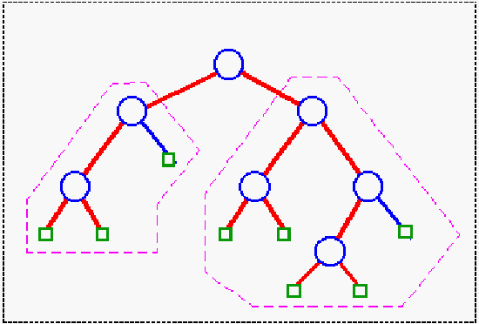
Trees: Introduction
A Tree is a hierarchical ADT where data is related in terms of parent-child relationships.
Each element (node) in the tree has at most 1 parent.
Each element (node) may have 0 or more children.
Each tree will include exactly one element (node), known as the root, which has no parent. All other elements (nodes) have 1 parent.
Trees can be defined recursively:
A tree T consists of a root node, r, plus a set of subtrees whose roots are children of r.

Slide 3
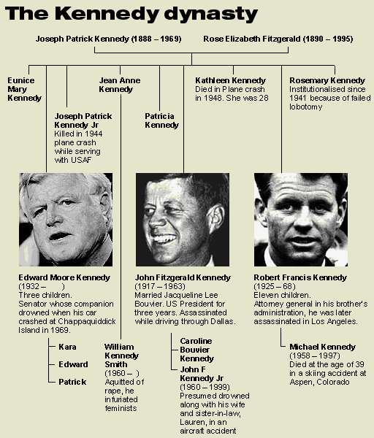
Trees: Introduction
A Tree is a hierarchical ADT where data is related in terms of parent-child relationships.
Each element (node) in the tree has at most 1 parent.
Each element (node) may have 0 or more children.
Each tree will include exactly one element (node), known as the root, which has no parent.
Trees can be defined recursively:
A tree T consists of a root node, r, plus a set of subtrees whose roots are children of r.
Trees occur throughout the real world:
Family Trees

Slide 4
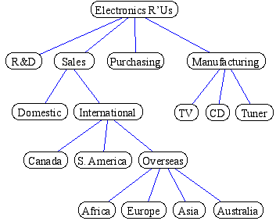
Trees: Introduction
A Tree is a hierarchical ADT where data is related in terms of parent-child relationships.
Each element (node) in the tree has at most 1 parent.
Each element (node) may have 0 or more children.
Each tree will include exactly one element (node), known as the root, which has no parent.
Trees can be defined recursively:
A tree T consists of a root node, r, plus a set of subtrees whose roots are children of r.
Trees occur throughout the real world:
Family Trees
Company Structures

Slide 5
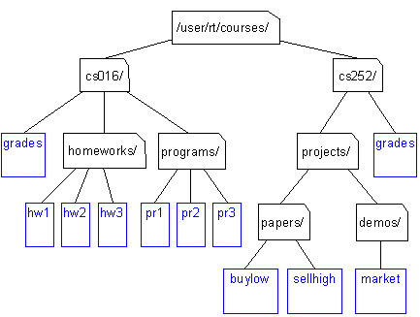
Trees: Introduction
A Tree is a hierarchical ADT where data is related in terms of parent-child relationships.
Each element (node) in the tree has at most 1 parent.
Each element (node) may have 0 or more children.
Each tree will include exactly one element (node), known as the root, which has no parent.
Trees can be defined recursively:
A tree T consists of a root node, r, plus a set of subtrees whose roots are children of r.
Trees occur throughout the real world:
Family Trees
Company Structures
File Systems

Slide 6
Trees: Terminology
Root of tree: A
The only node with no parent
A
B
C
D
E
F
G
I
H
J
K
L

Slide 7
Trees: Terminology
Root of tree: A
Parent of H: F
C is the parent of F
A is the parent of C
A
B
C
D
E
F
G
I
H
J
K
L

Slide 8
Trees: Terminology
Root of tree: A
Parent of H: F
Children of J: K and L
K is a child of J
L is a child of J
A
B
C
D
E
F
G
I
H
J
K
L

Slide 9
Trees: Terminology
Root of tree: A
Parent of H: F
Children of J: K and L
Siblings have the same parent.
Sibling of F: G
Sibling of G: F
H does not have a sibling!
A node is not a sibling of itself.
A
B
C
D
E
F
G
I
H
J
K
L

Slide 10
Trees: Terminology
Root of tree: A
Parent of H: F
Children of J: K and L
Sibling of F: G
Internal Nodes: A, B, I
Any node that has children
A,B,I are just examples: there are 7 total internal nodes in this tree.
A
B
C
D
E
F
G
I
H
J
K
L

Slide 11
Trees: Terminology
Root of tree: A
Parent of H: F
Children of J: K and L
Sibling of F: G
Internal Nodes: A, B, I
External Nodes: D, H, L
Any node that has no children
Also known as leaf nodes, or leaves.
There are 5 total external nodes in this tree.
A
B
C
D
E
F
G
I
H
J
K
L

Slide 12
Trees: Terminology
Root of tree: A
Parent of H: F
Children of J: K and L
Sibling of F: G
Internal Nodes: A, B, I
External Nodes: D, H, L
Ancestor of I: A, C, G, and I
A node u is an ancestor of v iff u = v or u is an ancestor of the parent of v
NB: This definition means that each node is an ancestor of itself: different to the meaning of “ancestor” in a human family tree.
A
B
C
D
E
F
G
I
H
J
K
L

Slide 13
Trees: Terminology
Root of tree: A
Parent of H: F
Children of J: K and L
Sibling of F: G
Internal Nodes: A, B, I
External Nodes: D, H, L
Ancestor of I: A, C, G, or I
Descendent of I: I, J, K, or L
A node v is a descendent of u iff u is an ancestor of v
NB: In the same way as before, this means that every node is a descendent of itself.
A
B
C
D
E
F
G
I
H
J
K
L

Slide 14
Trees: Terminology
Root of tree: A
Parent of H: F
Children of J: K and L
Sibling of F: G
Internal Nodes: A, B, I
External Nodes: D, H, L
Ancestor of I: A, C, G, or I
Descendent of I: I, J, K, or L
Edge: pair (u,v) such that u is the parent of v
E.g. (A, B), (G, I)
(A, G) is not an edge
(C, F) is an edge, but (F, C) is not: parent must come first.
A
B
C
D
E
F
G
I
H
J
K
L

Slide 15
Trees: Terminology
Root of tree: A
Parent of H: F
Children of J: K and L
Sibling of F: G
Internal Nodes: A, B, I
External Nodes: D, H, L
Ancestor of I: A, C, G, or I
Descendent of I: I, J, K, or L
Edge: pair (u,v) s.t. u is the parent of v
Path: sequence ( n₁, ..., n_{i} ) such that consecutive nodes are edges
E.g. (A, C, G, I)
(A, B, G) is not a path
(E, B, A) is not a path: paths must flow from parents to children.
A
B
C
D
E
F
G
I
H
J
K
L

Slide 16
Trees: Properties
Depth of a node, v: the number of ancestors of v excluding v itself.
Depth(A) = 0
Depth(G) = 2
Depth(E) = 2
Depth(K) = 5
Recursive definition for depth of a node, u:
u is the root: depth(u) = 0
u is not the root: depth(u) = 1 + depth(parent(u))
Depth is sometimes referred to as the level of the node in the tree.
Degree of a node, v: the number of children of v.
degree(A) = 2, degree(G) = 1, degree(E) = 0
A
B
C
D
E
F
G
I
H
J
K
L

Slide 17
Trees: Properties
Height of a tree T: the maximum depth of an external node of T.
height(T) = 5
Mathematically defined in terms of the height of a node, v:
v is external: height(v) = 0
v is internal: height(v) = 1 + max. height of v’s children
Example:
height(A) = 1 + max(height(B), height(C))
height(B) = 1 + max(height(D), height(E))
height(D) = height(E) = 0
...
A
B
C
D
E
F
G
I
H
J
K
L

Slide 18
Tree ADT
Trees make use of the Node ADT and have the following operations:
root() returns the Node for the root of the tree
parent(n) returns the Node of n’s parent
children(n) returns an Iterator of the Nodes of n’s children
isInternal(n) does n have children (internal node)?
isExternal(n) is n a leaf (external node)?
isRoot(n) is n==root()?
size() number of nodes
isEmpty() tests whether or not the tree is empty
iterator() returns an Iterator of every element in the tree
nodes() returns an Iterator of every Node in the tree
replace(n, e) replaces the element at Node n with e

Slide 19
INode Java Interface
Some Java programmers use a convention where the name of all interfaces starts with a capital ‘I’.
This helps to show the difference between an interface and an implementing class.
public interface INode<T> {
public T element();
}
Note that we are using generics this semester.
Now that you have covered these in OOP, we can use them to make our data structures more user-friendly.
We will practice this during the early labs.
Notes:
NB: These interfaces are slightly different to those given in the Goodrich & Tamassia book.

Slide 20
ITree Java Interface
public interface ITree<T> {
public INode<T> root();
public INode<T> parent(INode<T> n);
public IIterator<INode<T>> children(INode<T> n);
public boolean isInternal(INode<T> n);
public boolean isExternal(INode<T> n);
public boolean isRoot(INode<T> n);
public int size();
public boolean isEmpty();
public IIterator<T> iterator();
public IIterator<INode<T>> nodes();
public T replace(INode<T> n, T e);
}

Slide 21
Summary
Introduction to trees.
Tree vocabulary (what is a parent/child/subtree/ancestor/descendent/internal nodes/etc.).
Some tree properties (depth/height/etc.).
Tree ADT.
Java Interface for a tree.

